Slide 1

Introduction to Vuforia

Slide 2

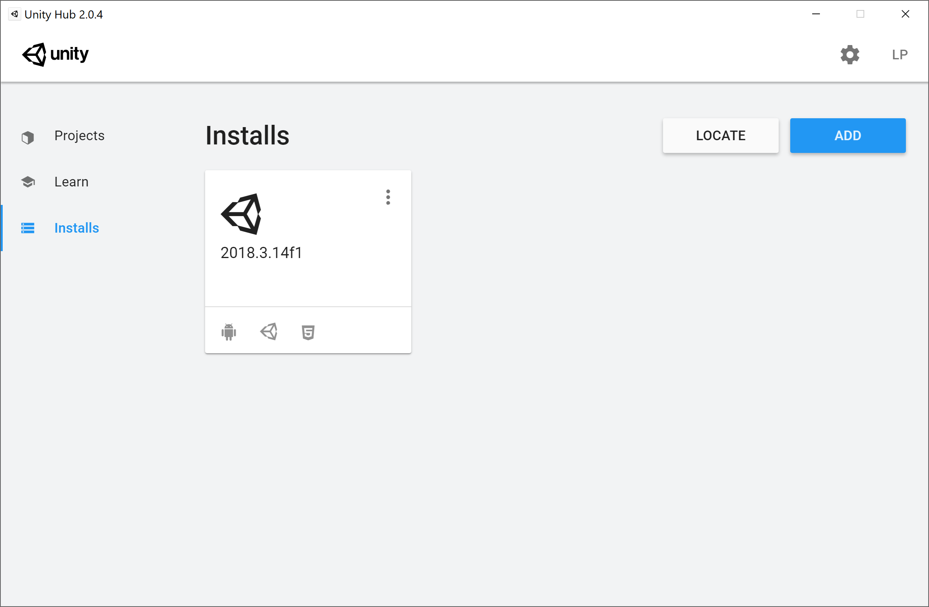
Installing Vuforia support
In the Unity Hub, go to Installs
Click on the three vertical dots

Slide 3
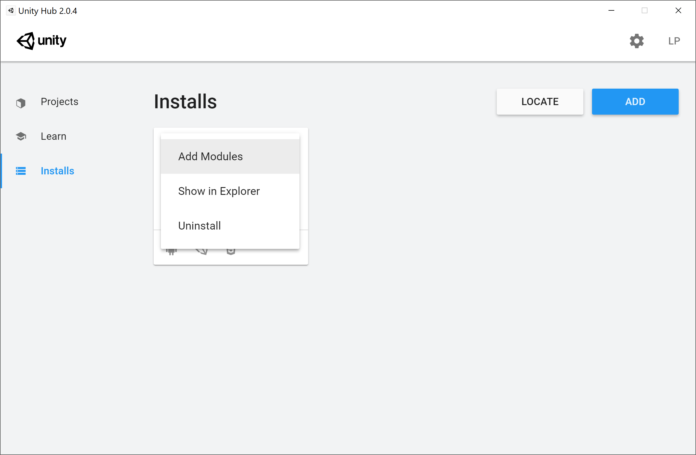
Installing Vuforia support
Select “Add modules”

Slide 4
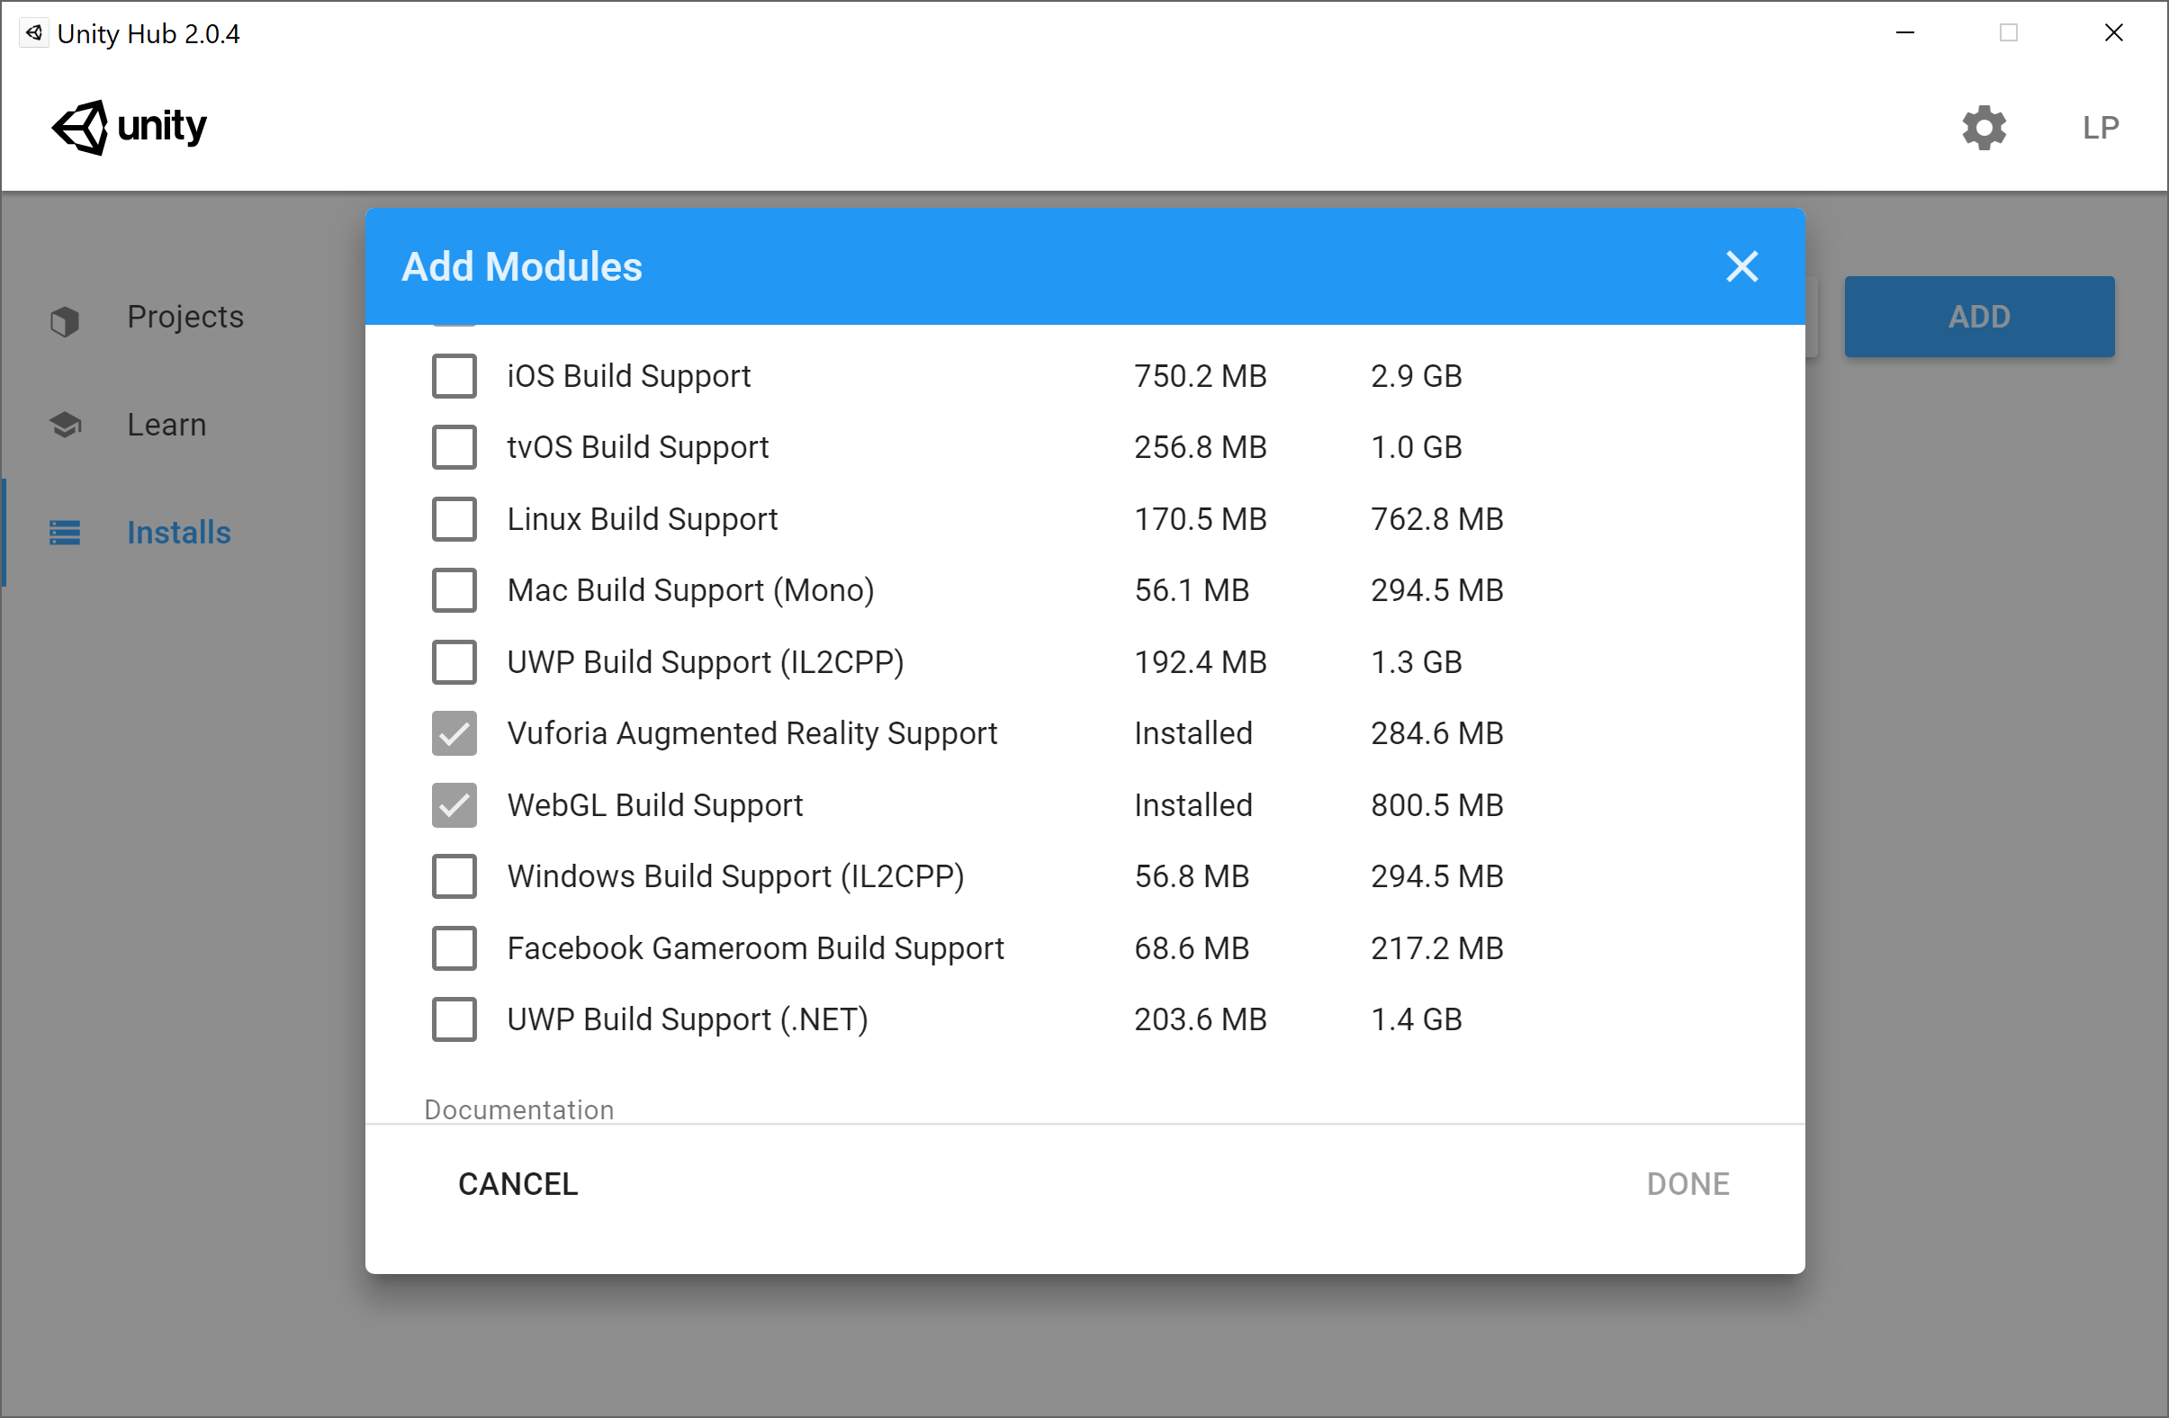
Installing Vuforia support
Select “Vuforia Augmented Reality Support” and click DONE

Slide 5
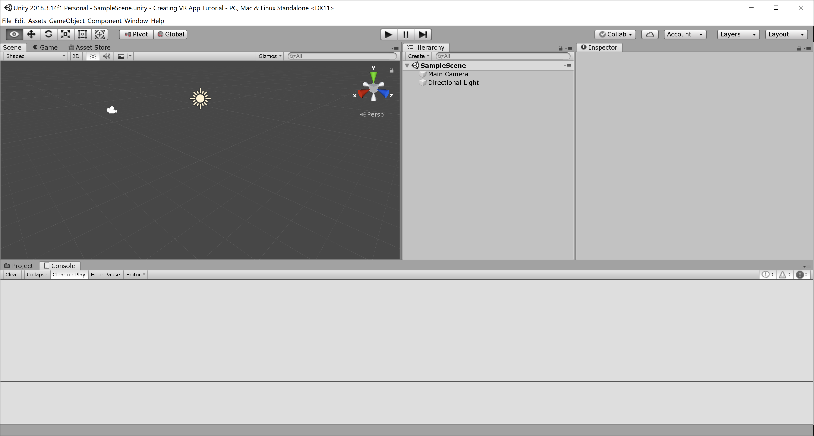
Getting started
Create a new project in Unity

Slide 6
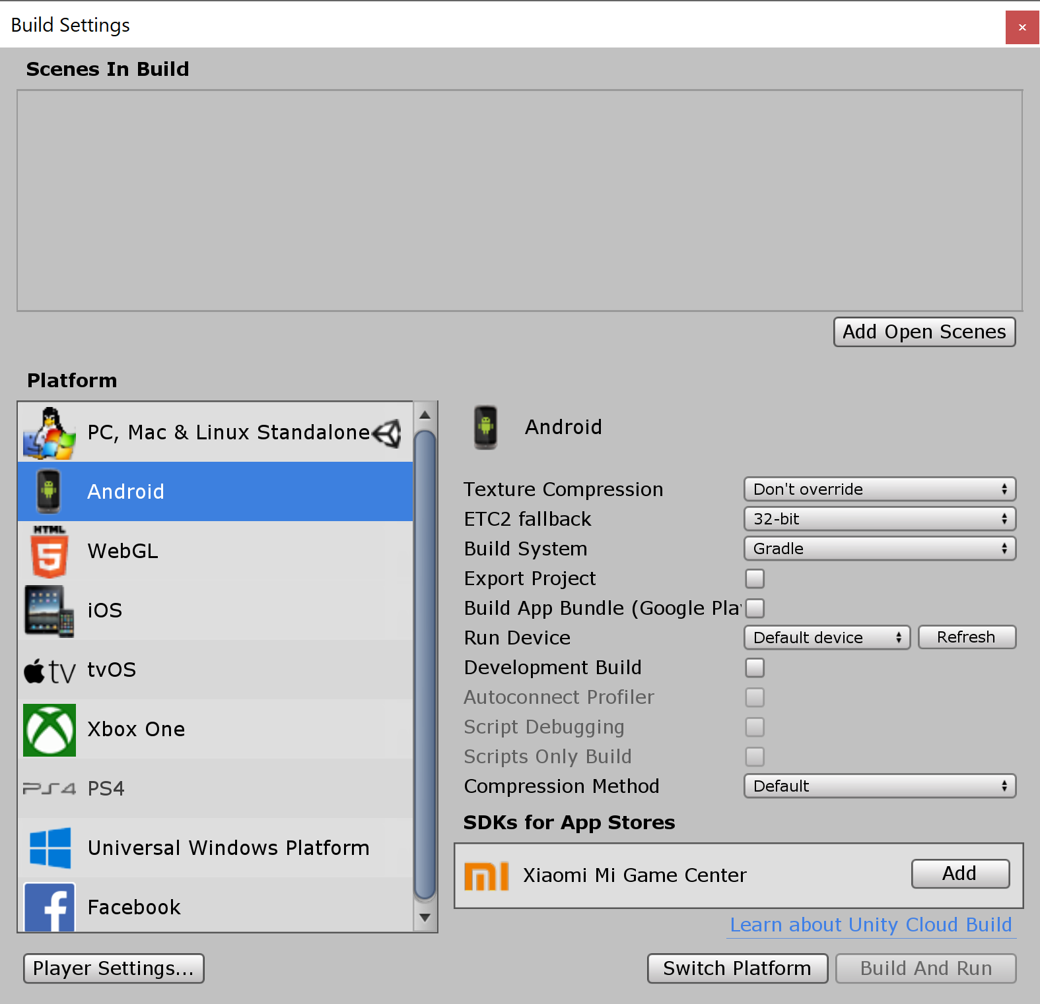
Getting started
Change the build settings to select your desired platform
Click “Switch Platform”

Slide 7
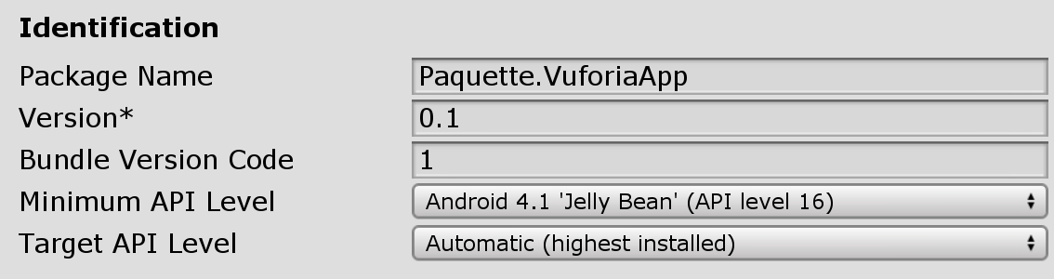

Getting started
Click on “Player Setting”
For Android:
Under “Other Settings”
change the “Package Name”
Deactivate support for “Android TV Compatibility”

Slide 8
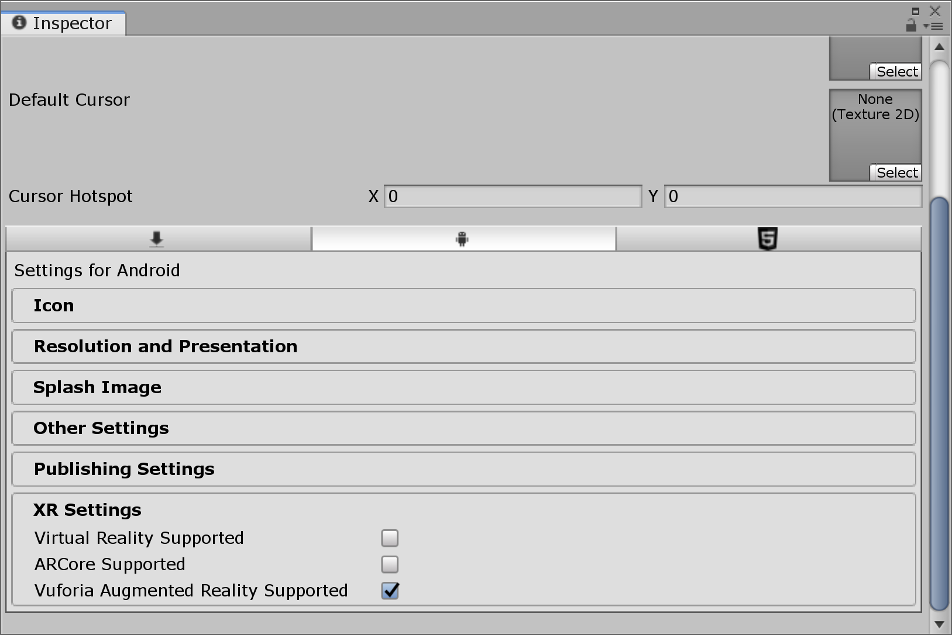
Getting started
Click on “Player Setting”
For Android:
Activate “Vuforia Augmented Reality Supported” under “XR Settings

Slide 9
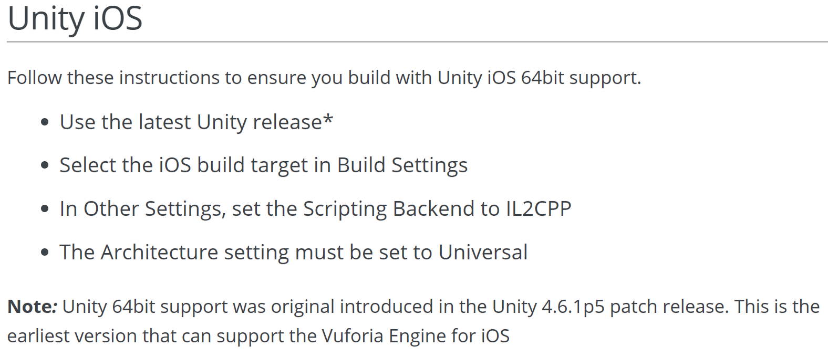
Getting started
Click on “Player Setting”
For iOS:
(see tutorial https://library.vuforia.com/articles/Solution/Getting-Started-with-Vuforia-for-iOS-Development.html)

Slide 10
Setting up the camera
The AR application doesn’t use the usual camera to display the scene
Instead, the camera makes use of the phone’s video camera to display the “real world”
The first thing to do is to delete the existing camera and replace it with an AR camera

Slide 11
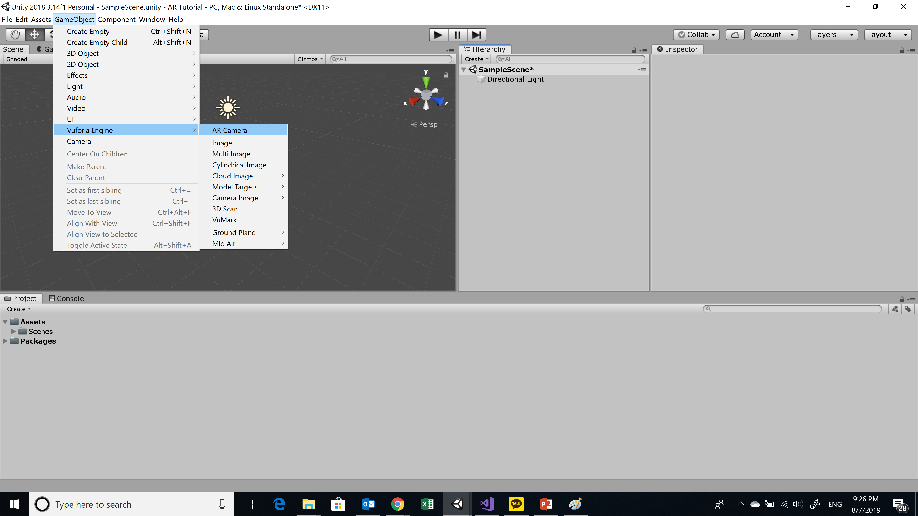
Setting up the camera
In the “GameObject” menu, select Vuforia Engine → AR Camera

Slide 12
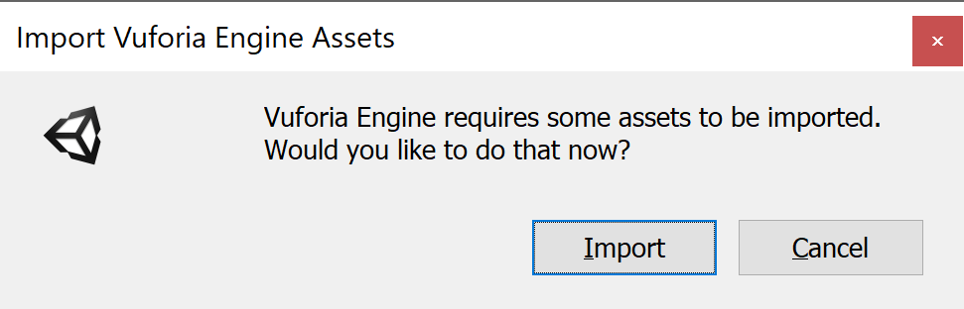
Setting up the camera
The will ask you if you would like to import the required Vuforia assets
Click “Import”

Slide 13
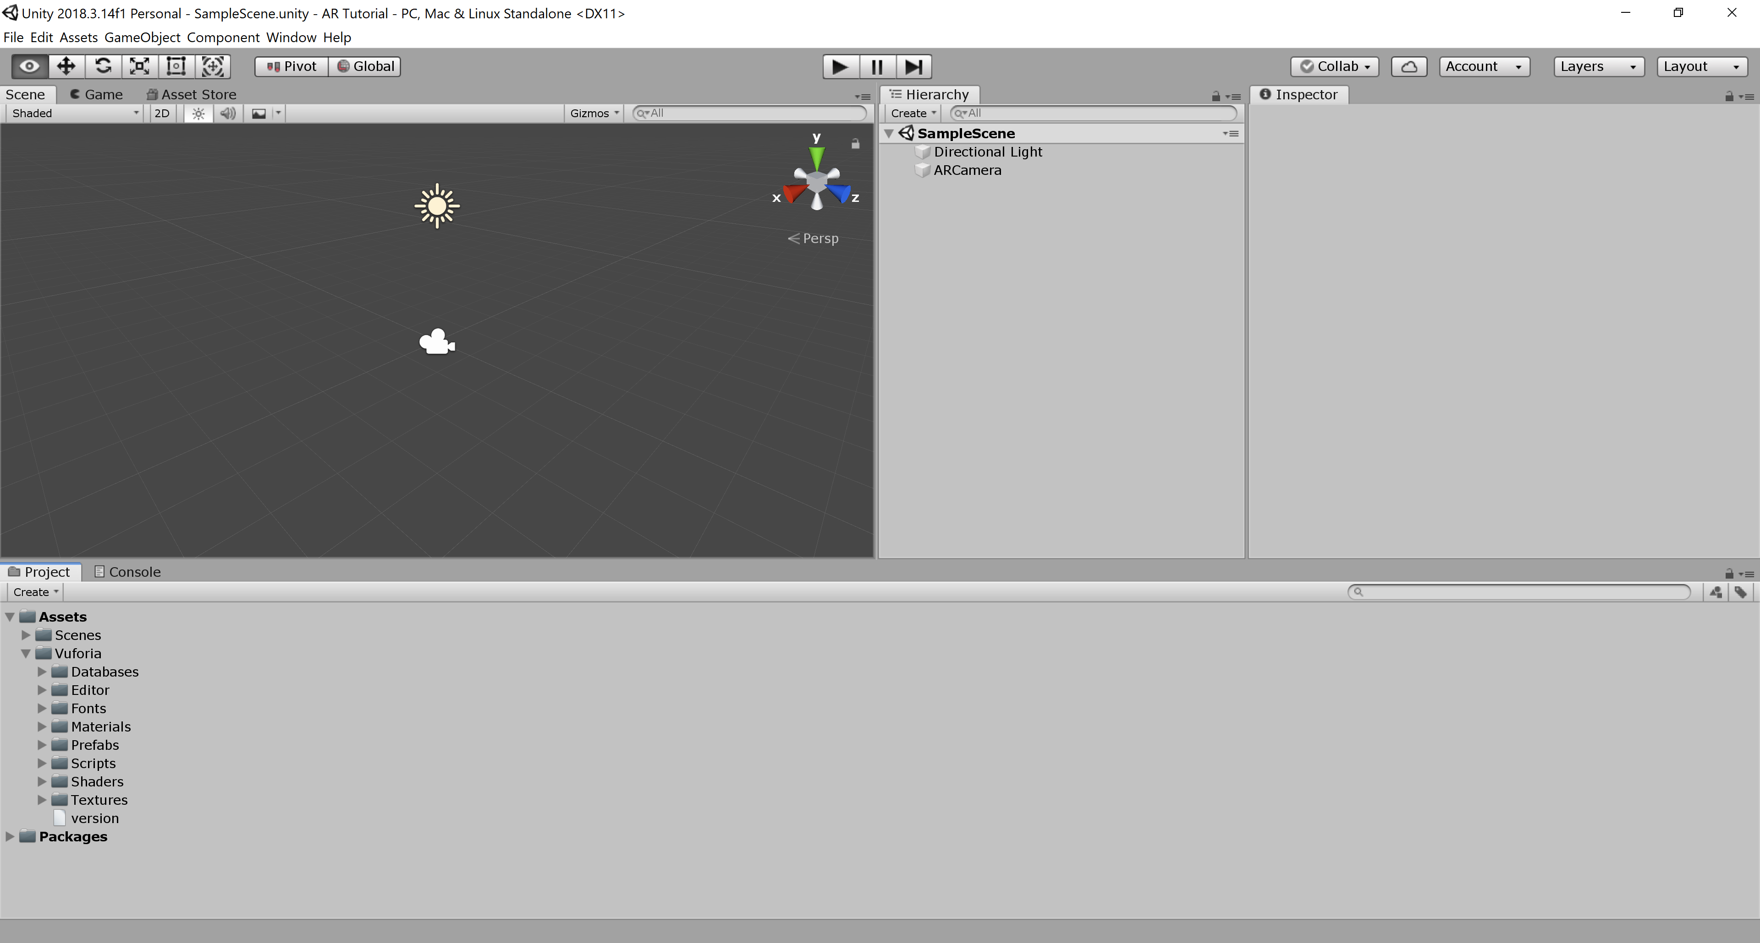
Setting up the camera
You can see those assets in the “Project” window

Slide 14
Setting up the camera
You can see those assets in the “Project” window

Slide 15
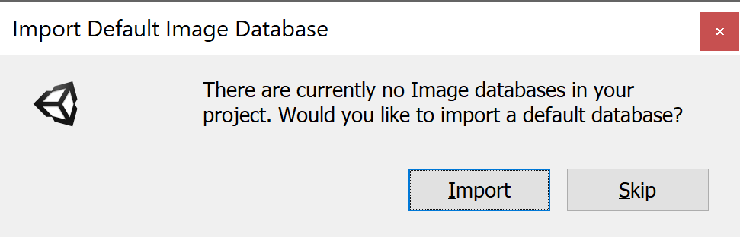

Adding an image target
Add an image target to your scene
In the “GameObject” menu, select Vuforia Engine → Image

Slide 16
Adding an image target
This will ask you if you would like to import the default image target database
Select “Import”

Slide 17
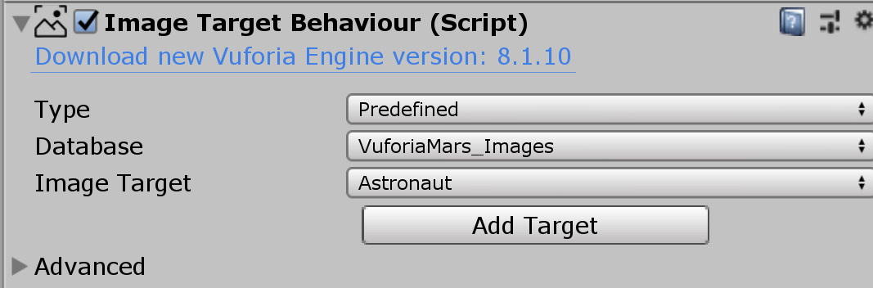

Adding an image target
The image target objects will contain an “Image Target Behavior” component
It specifies which database of target image to use and which image to use from this database
For example, using the “VuforiaMars_Images” database, the image target “Astronaut” can be detected by the AR camera

Slide 18
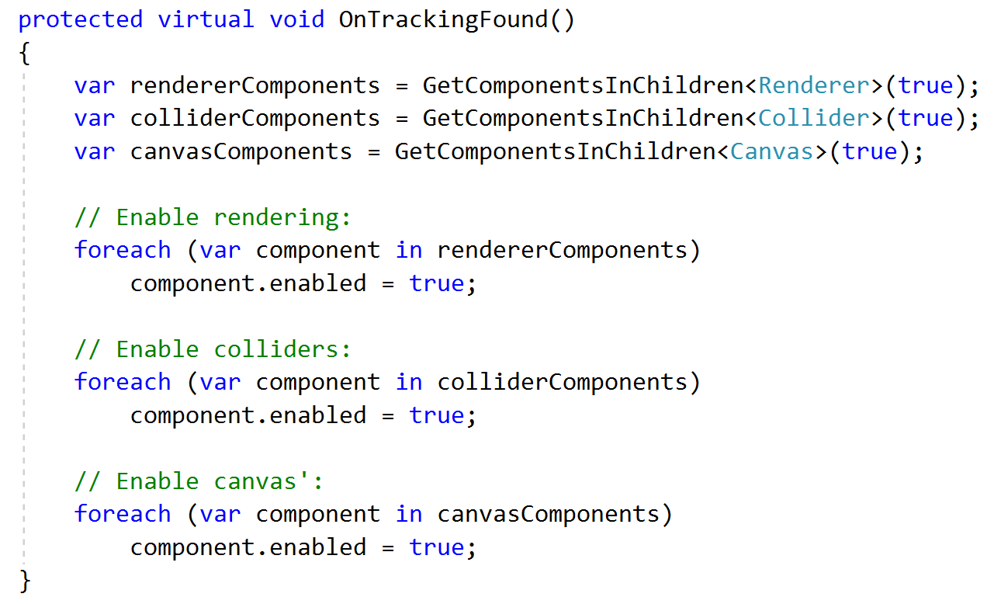
Adding an image target
The image target objects also contains a “Default Trackable Handler” component
It specifies a script that is executed when the target image is captured by the camera
This default behaviors hides any objects that are children of the image target object in the hierarchy (deactivate their renderer) and deactivate their collision when the target is not captured by the camera

Slide 19
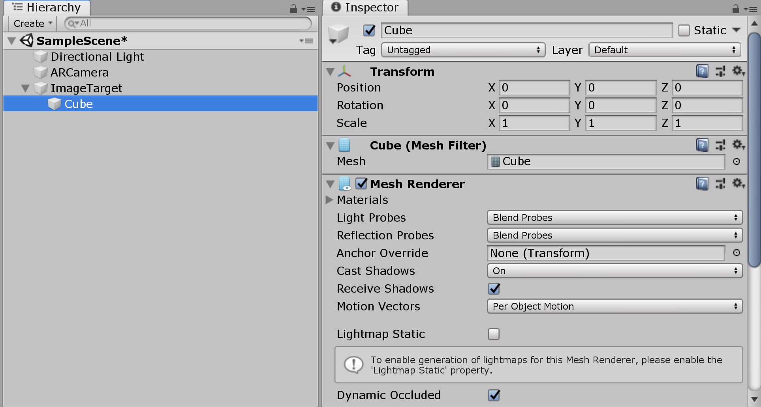
Associating 3D objects to the image target
Create an object and add it as a child of the image target

Slide 20
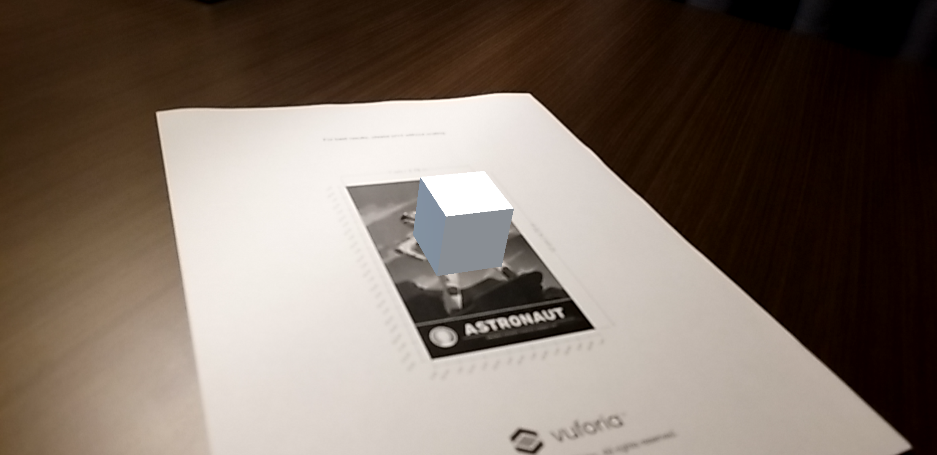
Associating 3D objects to the image target
The object will be displayed on the image target when the AR camera is pointed at it

Slide 21
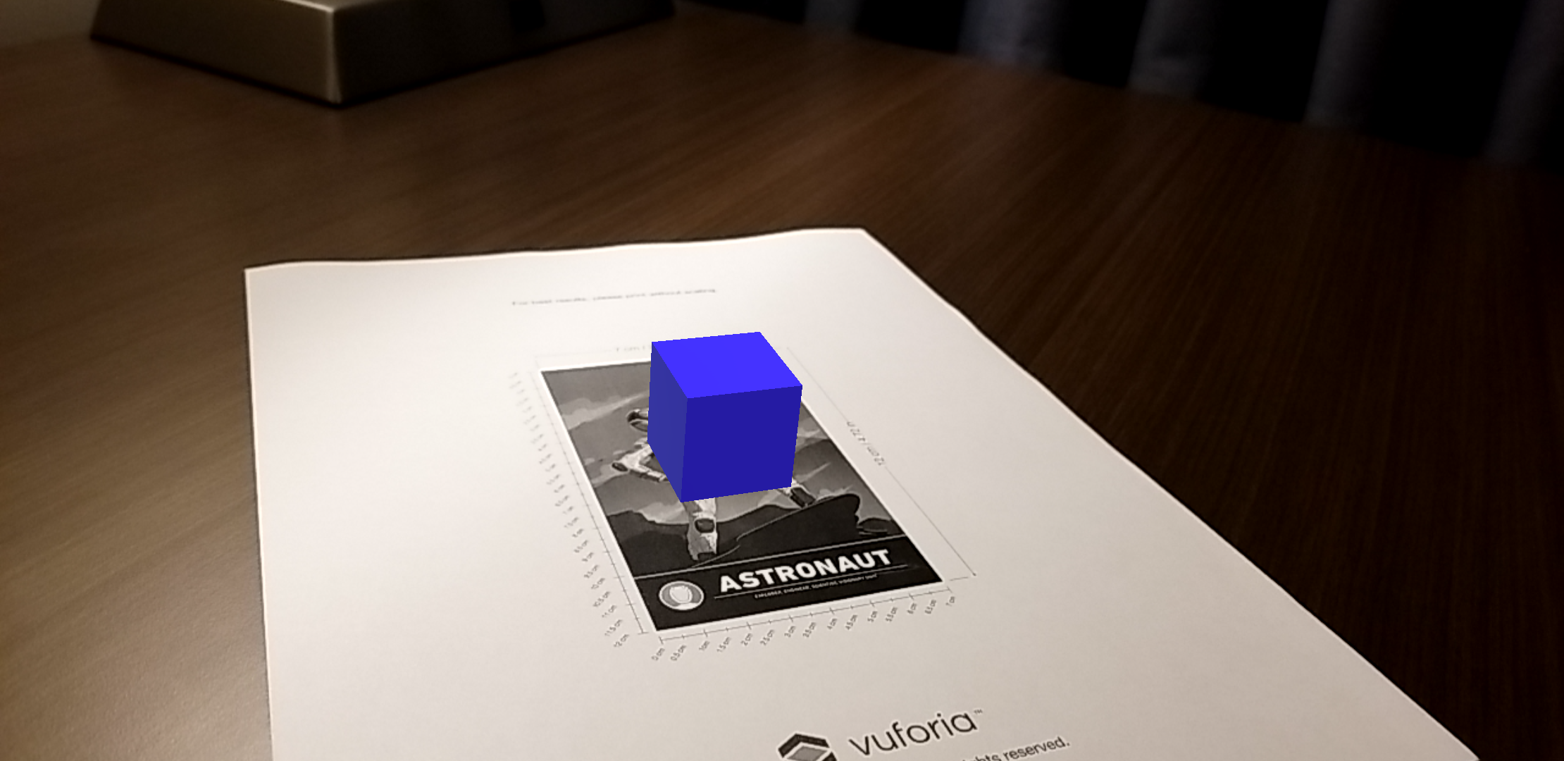
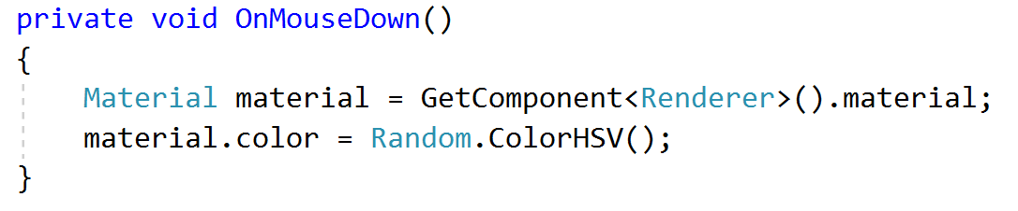
Implementing object behavior
Scripts can be associated to the object to allow the user to interact with it
For example, tapping the object can randomly change its color

Slide 22
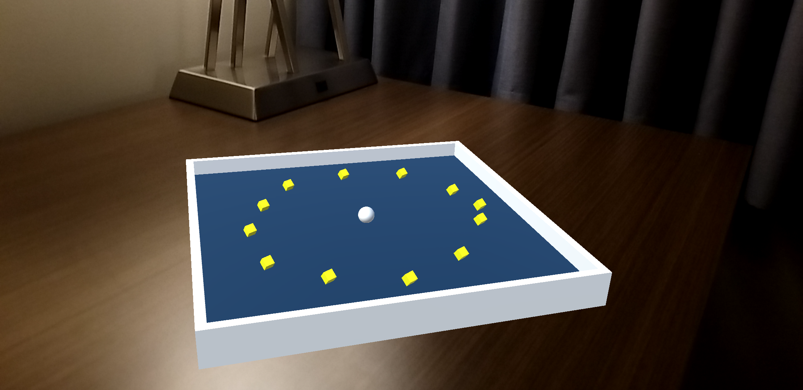
Advanced challenge
Make an AR version of the Roll-a-ball game
Warning: this is not an easy task because of the way that Vuforia handles showing/hiding objects and the way Vuforia moves/rotates the objects to display them over the target as the phone moves

